Slide 1
FOURIER ANALYSIS OF NUMERICAL INTEGRATION IN MONTE CARLO RENDERING
Kartic Subr Gurprit Singh Wojciech Jarosz
Heriot Watt University Dartmouth College Dartmouth College

Slide 2
This course …
Aims, objectives, etc.

Slide 3
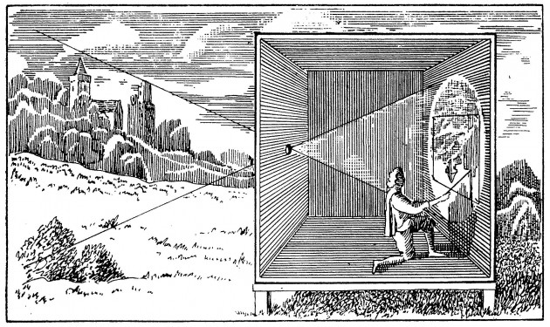

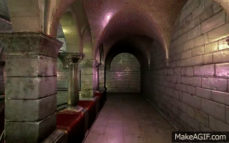
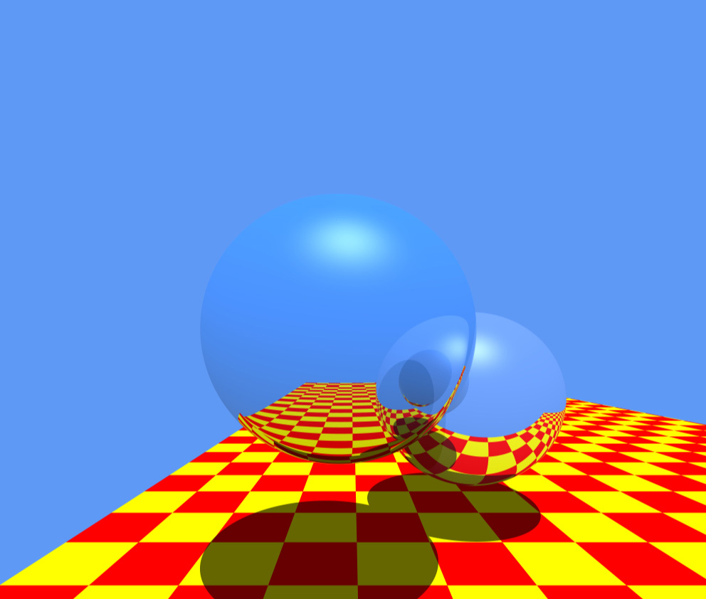
Rendering = geometry + radiometry
geometry/projection
for pin-hole model known since 400BC
radiometrically accurate simulation
is important for photorealism
OpenGL
Raytracing
[Stachowiak 2010]
[Whitted 1980]
camera obscura
[photo credit: videomaker.com June 2015]

Slide 4
Rendering = geometry + radiometry
geometry/projection
for pin-hole model known since 400BC
radiometrically accurate simulation
is important for photorealism
OpenGL
Raytracing
[Stachowiak 2010]
[Whitted 1980]
[photo credit: videomaker.com June 2015]

Slide 5
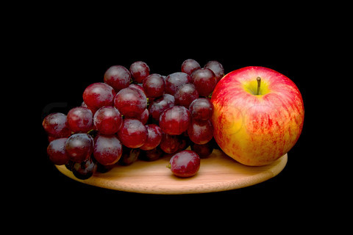
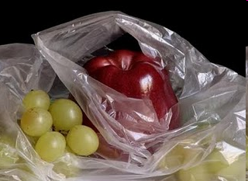

Radiometric fidelity improves photorealism
photograph
manually painted
computer generated
Colourbox.com
Pedro Campos

Slide 6


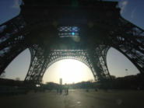




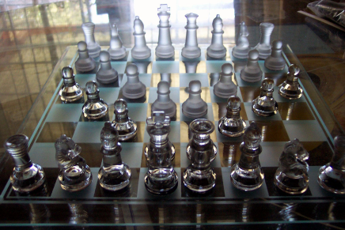
Simulating the physics of light is challenging
defocus
exposure time
lenses
light, media
materials

Slide 7


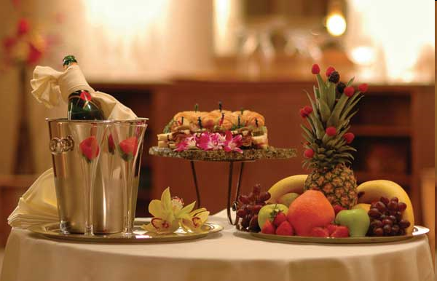
Light transport
virtual
light emitter
virtual
camera
Image ?
virtual scene: geometry + materials
estimate incident radiance at all pixels
on the virtual sensor
exitant radiance
W
m² Sr

Slide 8








Each reflection is modelled by an integration
radiance:

Slide 9
Each reflection is modelled by an integration
radiance:

Slide 10
Each reflection is modelled by an integration
radiance:

Slide 11
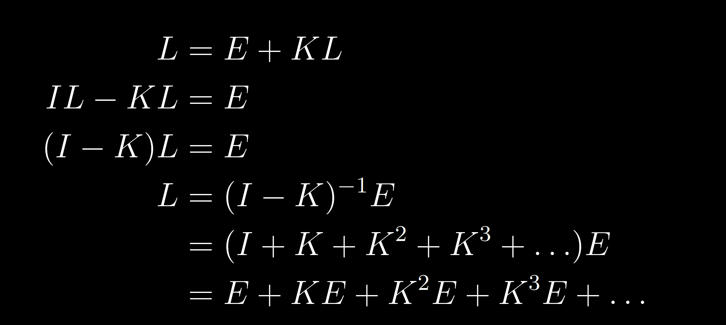
Light transport: recursive integral equation
radiance
emitted radiance
integral operator
The Rendering equation [Kajiya 86]
Light Transport Operators [Arvo 94]

Slide 12
L is a sum of high-dimensional integrals
radiance
integral operator
emitted radiance
One bounce
Three bounces

Slide 13
Reconstruction and integration in rendering

Slide 14

Reconstruction: estimate image samples
ground truth (high-res) image
reconstruct on (low-res) pixel grid
Y
Y
X
X

Slide 15
Naïve method: sample image at grid locations
ground truth (high-res) image
reconstruct on (low-res) pixel grid
Y
Y
sampling
copy
X
X

Slide 16
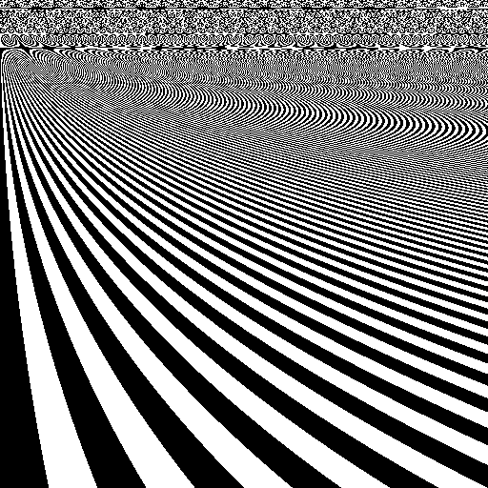
Naïve method: when sampling is increased
ground truth (high-res) image
reconstruct on (low-res) pixel grid
aliasing
Y
Y
X
X

Slide 17
Antialiasing: assuming `square’ pixels
Y
Y
multi-sampling
average
X
X

Slide 18
Antialiasing is costly due to multi-sampling
Y
Y
X
X

Slide 19
Antialiasing using general reconstruction filter
Y
Y
multi-sampling
weighted
average
X
X

Slide 20

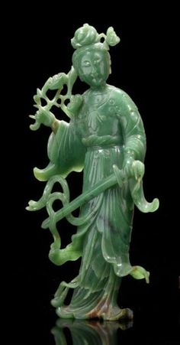


Rendering: Reconstructing integrals
path 1
Y
path 2
multi-sampling
for reconstruction
multi-path sampling
for integration
estimate per sampled pixel
path 3
X

Slide 21
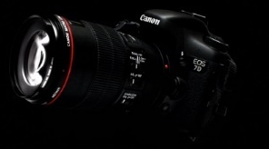
Function-space view: Sampling in path space
each sample represents a path
and has an associated radiance value
light
light paths
camera
n-dimensional path space
Notes:
3 trillion paths and 16D

Slide 22
Sample locations shown in path-pixel space
n-dimensional path space
pixels on sensor
Notes:
Figure from SIGG course notes

Slide 23
Rendering = integration + reconstruction
path-space integration
(projection)
n-dimensional path space
pixel value (radiance)
reconstruction using
integrated radiance
pixels on sensor
pixels on sensor
Notes:
Figure from SIGG course notes

Slide 24


Rendering = integration + reconstruction
Shiny ball in motion
Shiny ball, out of focus
…
…
image
location
multi-dim integral
Integrand: radiance (W m⁻² Sr⁻¹)
Domain: shutter time x aperture area x 1st bounce x 2nd bounce
…

Slide 25


Abstracting away the application…
0
Notes:
So, we want to compute the integral of f(x) (shown in yellow). What if f(x) was discretized and stored in an array?
http://www.sciweavers.org/free-online-latex-equation-editor

Slide 26


the sampling function
integrand
sampled integrand
sampling function
multiply
Notes:
What I called the sampled integrand is simply the product of the function and the sampling function, in this case a regular grid, or a piece of the Dirac comb or Shah function.
http://www.sciweavers.org/free-online-latex-equation-editor

Slide 27
sampling func. decides integration quality
integrand
sampled function
sampling function
multiply
Notes:
It turns out, that this sampling function is vital in deciding the quality of numerical integration. There are two fundamental ways to improve this sampling function.

Slide 28
strategies to improve estimators
1. modify weights
2. modify locations
eg. quadrature rules, importance sampling, jittered sampling, etc.
Notes:
move eg =s to the middle

Slide 29
insight into impact: Fourier domain
1. modify weights
2. modify locations
analyse sampling function in Fourier domain
Notes:
bring fourier chunk after this

Slide 30


Fourier analysis: origin and intuition
Eigenfunction of the differential operator
Turns differential equations into algebraic equations
scaling
Notes:
\frac {\mathrm d} {\mathrm {d}x} e^{\lambda x} = \lambda e^{\lambda x}
f(x) = \sum\limits_{i=1}^N e^{\lambda_i x}, \quad \frac {\mathrm d} {\mathrm {d}x} f(x) = \sum\limits_{i=1}^N \lambda_i e^{\lambda_i x}

Slide 31

Fourier analysis: origin and intuition
Eigenfunction of the differential operator
Turns differential equations into algebraic equations
if
scaling
projection
Notes:
\frac {\mathrm d} {\mathrm {d}x} e^{\lambda x} = \lambda e^{\lambda x}
f(x) = \sum\limits_{i=1}^N e^{\lambda_i x}, \quad \frac {\mathrm d} {\mathrm {d}x} f(x) = \sum\limits_{i=1}^N \lambda_i e^{\lambda_i x}

Slide 32

The continuous Fourier transform
Fourier
domain
primal
(space, time, etc.)
domain
Notes:
\hat{f}(\omega) = \int\limits_{-\infty}^{\infty} f(x) e^{-2\pi \mathrm{\imath} \omega x} \mathrm{d}x

Slide 33

The Fourier transform: `frequency’ domain
frequency
domain
frequency
projection onto sin and cos
Notes:
\hat{f}(\omega) = \int\limits_{-\infty}^{\infty} f(x) e^{-2\pi \mathrm{\imath} \omega x} \mathrm{d}x
\hat{f}(\omega) = \int\limits_{-\infty}^{\infty} f(x) \cos ({2\pi \omega x}) \mathrm{d}x + \mathrm{\imath} \int\limits_{-\infty}^{\infty} f(x) \sin ({2\pi \omega x}) \mathrm{d}x

Slide 34
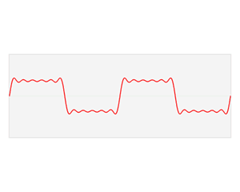
Fourier series approximation of square wave
Image credit: Wikipedia
Notes:
\hat{f}(\omega) = \int\limits_{-\infty}^{\infty} f(x) e^{-2\pi \mathrm{\imath} \omega x} \mathrm{d}x

Slide 35
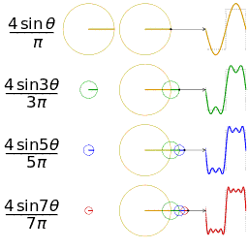
Fourier series: replace integral with sum
approximating a square wave using 4 sinusoids
Notes:
\hat{f}(\omega) = \int\limits_{-\infty}^{\infty} f(x) e^{-2\pi \mathrm{\imath} \omega x} \mathrm{d}x

Slide 36
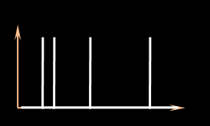


Computing the Fourier spectrum of the sampling function
amplitude (sampling spectrum)
sampling function
frequency
phase (sampling spectrum)
Notes:
To abstract away these approaches, we analyse the estimators based on the signature of the sampling function in the Fourier domain. eg. This plot shows the amplitude (yellow) and phase (blue) of the sampling signal.

Slide 37
sampling function = sum of Dirac deltas
+
+
+
Notes:
Any unweighted, sampling function can be expressed as the sum of impulses (or Dirac delta functions).

Slide 38

In the Fourier domain …
Fourier transform
Dirac delta
Frequency
Imaginary
amplitude
phase
Real
primal
Fourier
Complex plane
Notes:
The Fourier transform of a Dirac delta function is a constant (amplitude) with a phase that is linear in frequency (before the modulo 2pi)

Slide 39
Review: in the Fourier domain …
Fourier transform
Dirac delta
Frequency
Imaginary
Imaginary
Real
Real
primal
Fourier
Complex plane
Complex plane
Notes:
The Fourier transform of a Dirac delta function is a constant (amplitude) with a phase that is linear in frequency (before the modulo 2pi)

Slide 40
amplitude spectrum is not flat
Fourier transform
=
=
+
+
+
+
+
+
primal
Fourier
Notes:
The sampling spectrum is therefore the sum of several spectra with constant amplitudes. How does this produce non-constant sampling spectra?

Slide 41
sample contributions at a given frequency
1
2
3
4
5
At a given frequency
sampling function
Imaginary
3
5
1
Real
4
2
Complex plane
Notes:
Now imagine adding more impulses. In this case, the five spikes cause five samples on the dotted circle in the complex plane.

Slide 42
the sampling spectrum at a given frequency
sampling spectrum
Complex plane
given frequency
3
5
centroid
1
4
2
Notes:
Due to the linearity of the Fourier transform, the vector sum of these samples (or the centroid) is the resulting sampling spectrum, sliced at a given frequency. The amplitude spectrum is the distance of the centroid to the Origin and the phase describes the angular offset from the real axis.

Slide 43
the sampling spectrum at a given frequency
sampling spectrum instances
expected centroid
centroid variance
given frequency
Notes:
Over multiple instances of the sampling spectrum, the location of the centroid has an expected value and a variance (or 2D covariance).

Slide 44
expected sampling spectrum and variance
expected amplitude of sampling spectrum
variance of sampling spectrum
DC
frequency
Notes:
Here, the expected amplitude spectrum is shown with a yellow line and the variance (at each frequency) is denoted using an orange blur.

Slide 45
Abstracting sampling strategy using spectra
1. modify weights
2. modify locations
sampling function in the Fourier domain
amplitude (sampling spectrum)
eg. quadrature rules
a. Distribution eg. importance sampling)
frequency
phase (sampling spectrum)
Notes:
To abstract away these approaches, we analyse the estimators based on the signature of the sampling function in the Fourier domain. eg. This plot shows the amplitude (yellow) and phase (blue) of the sampling signal.

Slide 46
stochastic sampling & instances of spectra
Instances of sampling functions
Instances of sampling spectra
Sampler
(Strategy 1)
draw
Fourier
transform
Notes:
Remember that each instance of samples from the sampler produces a different sampling spectrum. Now given the many instances of sampling spectra from two different sampling strategies …

Slide 47
assessing estimators using sampling spectra
Instances of sampling functions
Instances of sampling spectra
Sampler
(Strategy 1)
Which strategy is better? Metric?
Sampler
(Strategy 2)
Notes:
the question we address is how we can compare the strategies, for use in numerical integration. But what is the basis of comparison?

Slide 48
accuracy (bias) and precision (variance)
Estimator 2 has lower bias but higher variance
reference
frequency
Estimator 1
Estimator 2
estimated value (bins)
Notes:
Given two estimators, we can now compare their respective biases and variances. But can we do such comparisons predictively?

Slide 49
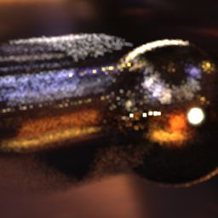

Variance and bias
predict as a function of sampling strategy and integrand
High variance
High bias
Notes:
So, we want to compute the integral of f(x) (shown in yellow). What if f(x) was discretized and stored in an array?
http://www.sciweavers.org/free-online-latex-equation-editor

Slide 50

Monte Carlo integration: summary and error
Error
MSE, bias, variance
convergence rate: error as N is increased
Notes:
\int\limits_0^1 \; f(x) \; \mathrm{d} x \approx \frac 1 N \sum\limits_{i=1}^N f(x_i), \quad x_i \sim \mathrm{Unif}([0,1])

Slide 51
Local variation is useful for adaptive sampling
path-space integration
(projection)
pixel value (radiance)
n-dimensional path space
integrated radiance
local variation/
anisotropy?
use in regression/reconstruction
pixels on sensor
pixels on sensor
Notes:
Figure from SIGG course notes

Slide 52
Return to integration and reconstruction
path-space integration
(projection)
pixel value (radiance)
n-dimensional path space
integrated radiance
local variation/
anisotropy?
use in regression/reconstruction
pixels on sensor
pixels on sensor

Slide 53
Frequency analysis of lightfields in rendering
local variation of integrand
reconstruction filter
path-space integration
(projection)
pixel value (radiance)
n-dimensional path space
integrated radiance
local variation/
anisotropy?
use in regression/reconstruction
pixels on sensor
pixels on sensor
[Ramamoorthy et al 04]
[Durand et al 05]
[Soler et al 2009]
[Egan et al 2009, 2011]
[Ramamoorthy et al 2012]

Slide 54
Freq. analysis of MC sampling: This course!
Assessing MSE, bias, variance and convergence
of Monte Carlo estimators as a function of the
Fourier spectrum of the sampling function.
n-dimensional path space
local variation/
anisotropy?
[Durand 2011]
[Ramamoorthy et al 12]
[Subr and Kautz 2013]
[Pilleboue et al 2015]
pixels on sensor

Slide 55
Freq. analysis of MC sampling: This course!
Assessing MSE, bias, variance and convergence
of Monte Carlo estimators as a function of the
Fourier spectrum of the sampling function.
n-dimensional path space
[Durand 2011]
[Ramamoorthy et al 12]
[Subr and Kautz 2013]
[Pilleboue et al 2015]

Slide 56
Freq. analysis of MC sampling: This course!
Assessing MSE, bias, variance and convergence
of Monte Carlo estimators as a function of the
Fourier spectrum of the sampling function.
n-dimensional path space
local variation/
anisotropy?
[Durand 2011]
[Ramamoorthy et al 12]
[Subr and Kautz 2013]
[Pilleboue et al 2015]

Slide 57
Freq. analysis of MC sampling: This course!
Assessing MSE, bias, variance and convergence
of Monte Carlo estimators as a function of the
Fourier spectrum of the sampling function.
n-dimensional path space
[Durand 2011]
[Ramamoorthy et al 12]
[Subr and Kautz 2013]
[Pilleboue et al 2015]

Slide 58
Freq. analysis of MC sampling: This course!
Assessing MSE, bias, variance and convergence
of Monte Carlo estimators as a function of the
Fourier spectrum of the sampling function.
n-dimensional path space
local variation/
anisotropy?
[Durand 2011]
[Ramamoorthy et al 12]
[Subr and Kautz 2013]
[Pilleboue et al 2015]

Slide 59


Bird’s-eye view of analysis
Rewrite MC estimator in terms of sampling function
where
Notes:
S(x) = \sum\limits_{i=1}^N \delta(x-x_i)
\frac 1 N \sum\limits_{i=1}^N f(x_i) = \int\limits_0^1 f(x) S(x) \; \mathrm{d}x
S(x) = \frac 1 N \sum\limits_{i=1}^N \delta(x-x_i)
\int\limits_0^1 f(x) S(x) \; \mathrm{d}x = \int\limits_{-\infty}^{\infty} \hat{f}(\omega) \hat{S}(-\omega) \; \mathrm{d}\omega

Slide 60

Bird’s-eye view of analysis
Rewrite MC estimator in terms of sampling function
Fourier transform preserves inner products, so
where
Notes:
S(x) = \sum\limits_{i=1}^N \delta(x-x_i)
\frac 1 N \sum\limits_{i=1}^N f(x_i) = \int\limits_0^1 f(x) S(x) \; \mathrm{d}x
S(x) = \frac 1 N \sum\limits_{i=1}^N \delta(x-x_i)
\int\limits_0^1 f(x) S(x) \; \mathrm{d}x = \int\limits_{-\infty}^{\infty} \hat{f}(\omega) \hat{S}(-\omega) \; \mathrm{d}\omega

Slide 61

Bird’s-eye view of analysis
Rewrite MC estimator in terms of sampling function
Fourier transform preserves inner products, so
Analyse MSE error, bias and convergence in terms of
where
Notes:
S(x) = \sum\limits_{i=1}^N \delta(x-x_i)
\frac 1 N \sum\limits_{i=1}^N f(x_i) = \int\limits_0^1 f(x) S(x) \; \mathrm{d}x
S(x) = \frac 1 N \sum\limits_{i=1}^N \delta(x-x_i)
\int\limits_0^1 f(x) S(x) \; \mathrm{d}x = \int\limits_{-\infty}^{\infty} \hat{f}(\omega) \hat{S}(-\omega) \; \mathrm{d}\omega

Slide 62
Closing slide … tbd

